Slide 1
FinTrack – Smart Income and Expense Management System
Presentation by
Sangm Subedi
Amit Baral
Prabin Shrestha

Slide 2
Introduction
Comprehensive financial management solution
Combines mobile app + web-based admin panel
Features:
  Log daily transactions
  Categorize spending
  Set budgets & review reports
Goal: Promote financial literacy & smart decision-making

Slide 3
Background Study
Challenges in financial management:
Poor budgeting & overspending
Manual tracking (time-consuming, error-prone)
Limited features in existing apps
FinTrack Solution:
Cloud-based, mobile-first platform
Receipt management (photo uploads)
Smart recommendations for better savings

Slide 4
Problem Statement
Difficulty maintaining income/expense records
Current tools: complex, expensive, or limited
Manual methods lack real-time updates

Slide 5
Objectives
Simple mobile app for tracking income/expenses
Family expense sharing for transparency
AI-powered spending analysis & advice
Secure admin panel for user & system management

Slide 6
Methodology
Agile Development Approach

Slide 7
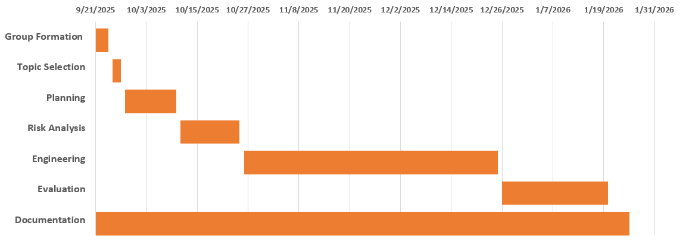
Gantt Chart

Slide 8
Deliverables
Mobile Application (income & expense logging)
User Manual (end-user guidance)
Documentation Report (design, implementation, testing)

Slide 9
Thank You! ☺

